Slide 1
Mottled Stars – Literature Review
How Does Starspot Coverage Affect Stellar Brightness Variability?
Miles L. Johnson

Slide 2
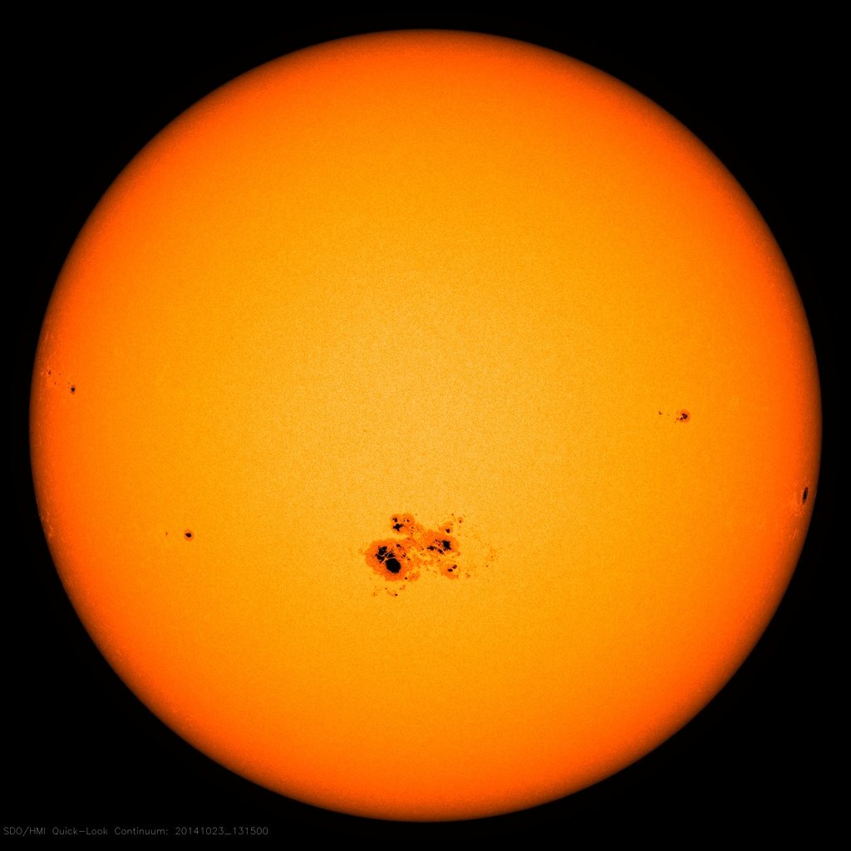
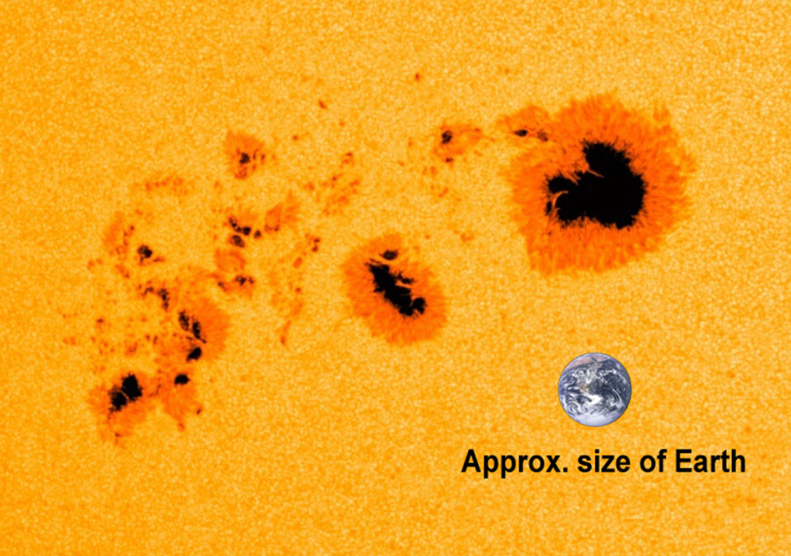
Sunspots/Starspots
Image Credit: NASA/SDO
Image Credit: NASA/SDO

Slide 3
The MOTTLED Stars project
Continuing the Mottled Stars Project
In 2018, Dr. Feiden worked with first-year undergraduate Amanda Ash
Title: Mottled Stars: Improving Age Estimates for Young Stars in the Planet Formation Era
Their Findings:
Showed (maybe for the first time) that starspots might just be transient features on the surface of some stars
Key Predictions:
Transient spots require that a star have 75% of its surface covered by spots
Spots that cause deep structural changes require that only half of the star to be covered by spots

